Slide 1
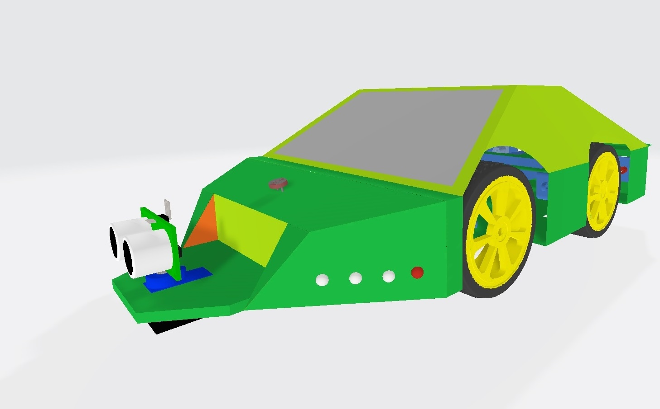
Voice
Controlled
Car
-By
Saurabh Kawli
Santosh Das

Slide 2
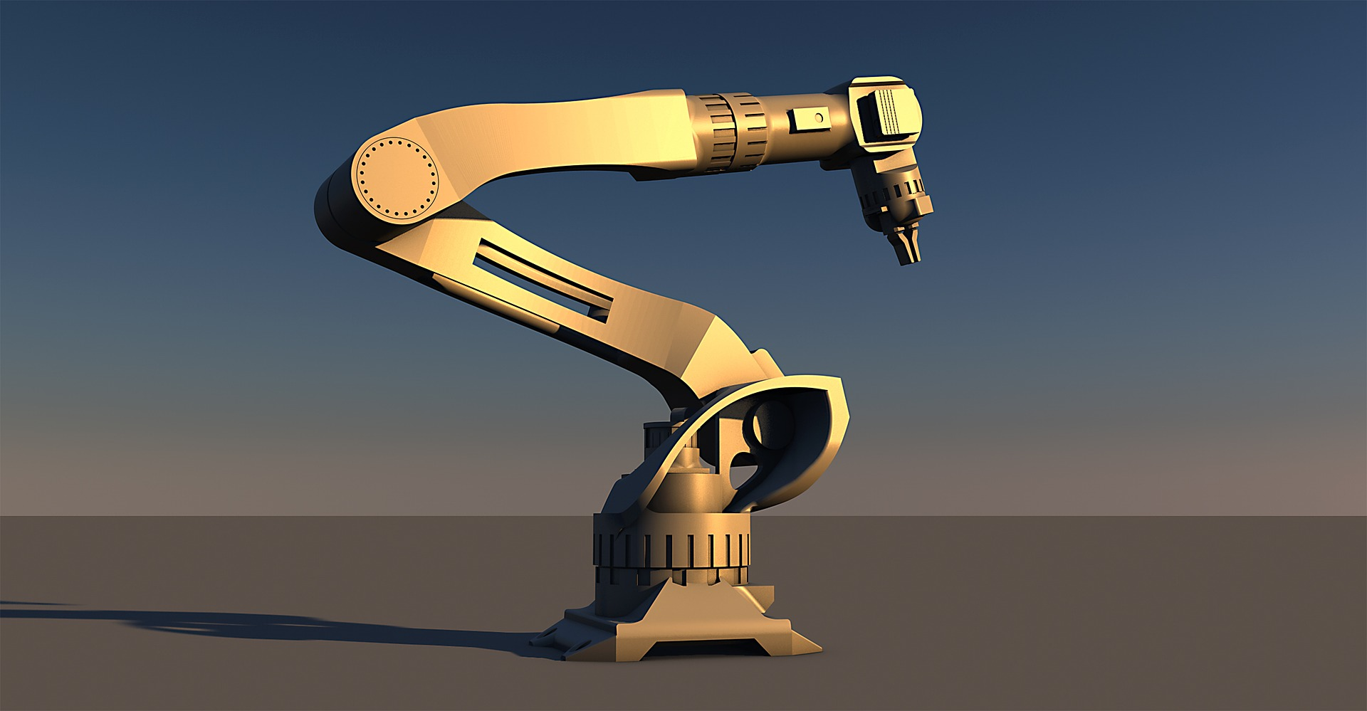
Overview of project
About the car
Circuit diagram
Advantages
limitation

Slide 3
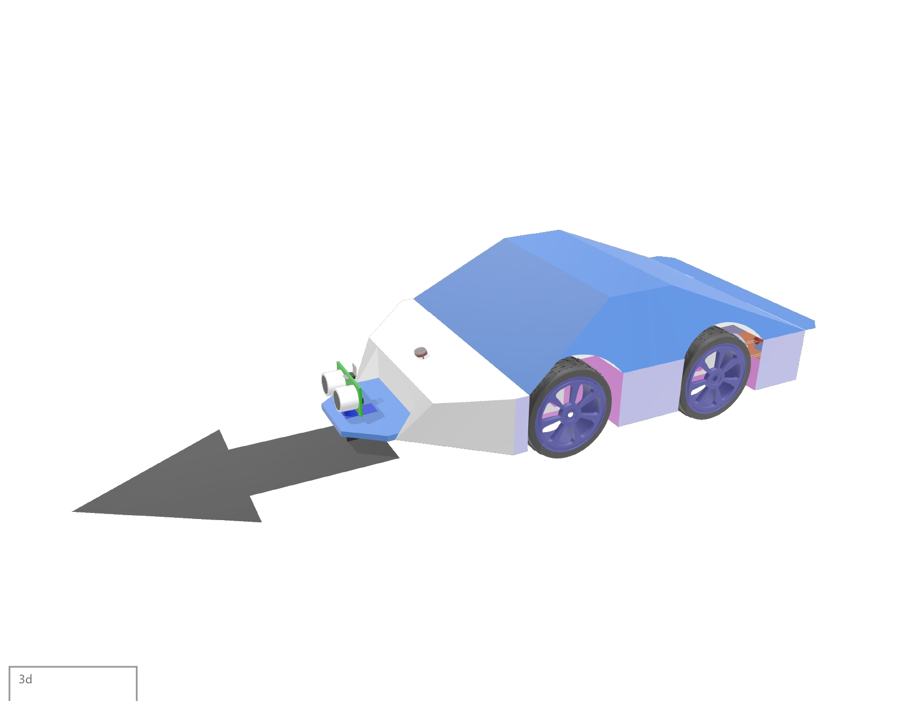
GO Command

Slide 4
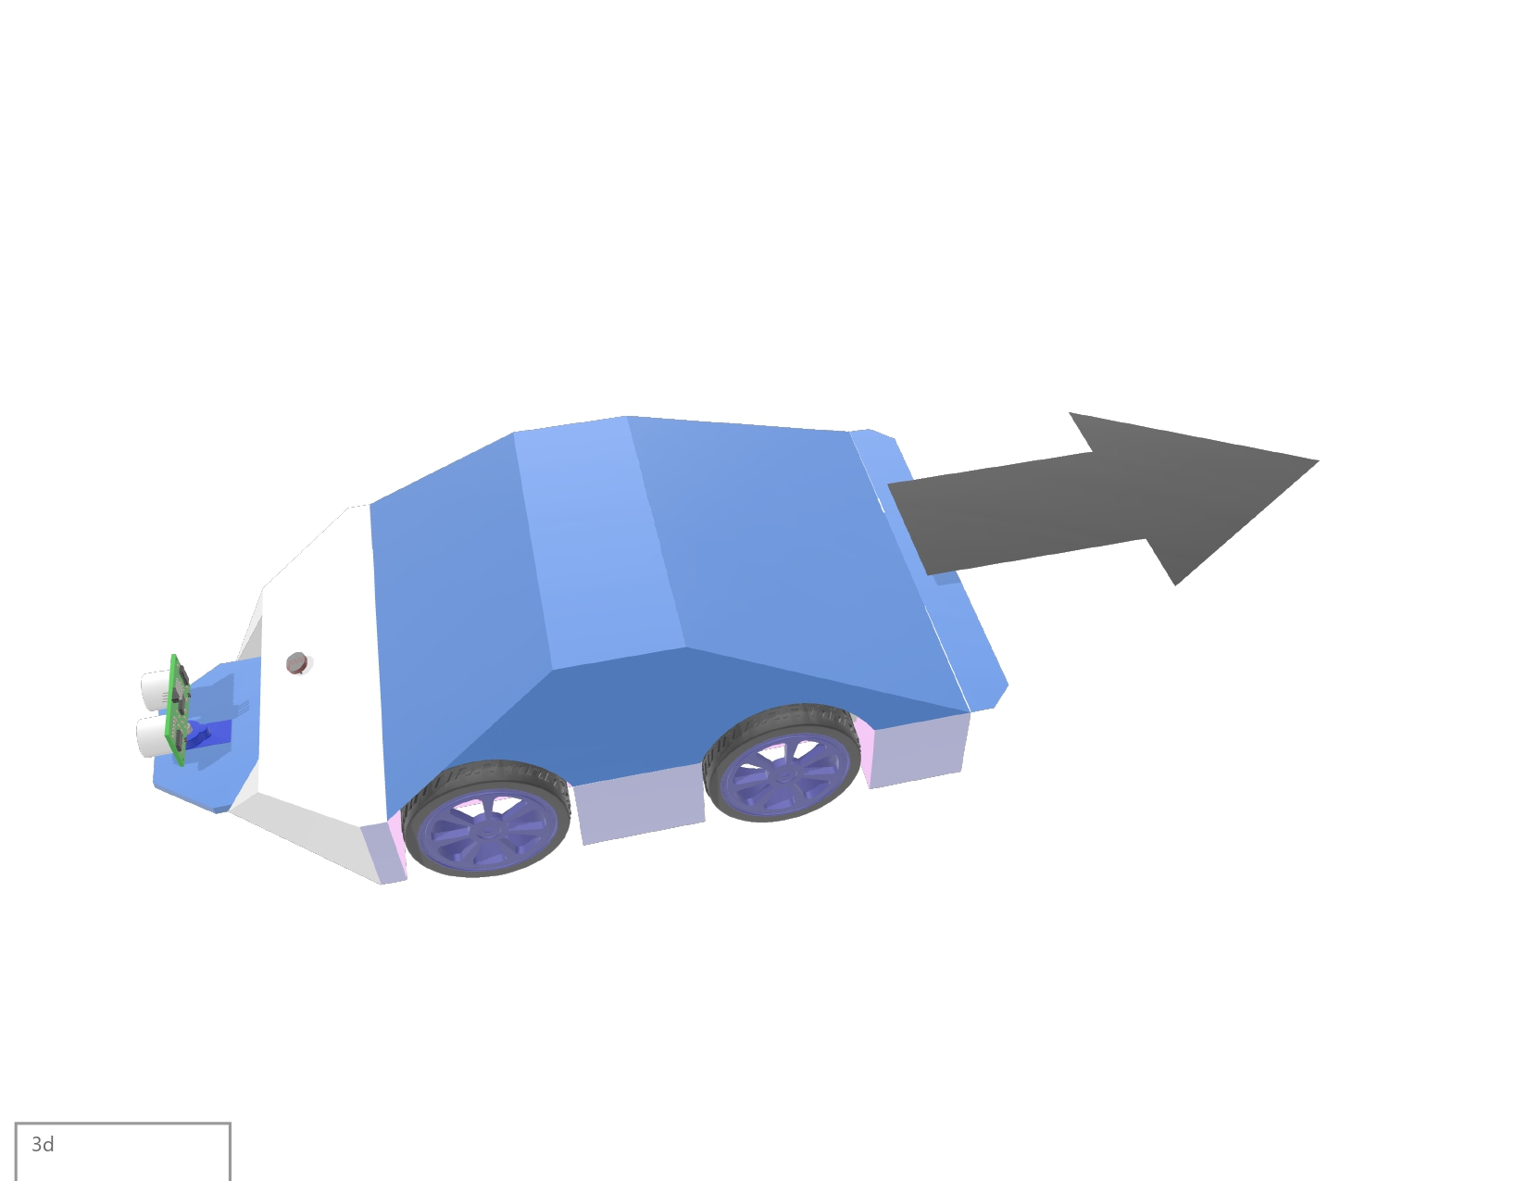
BACK Command

Slide 5
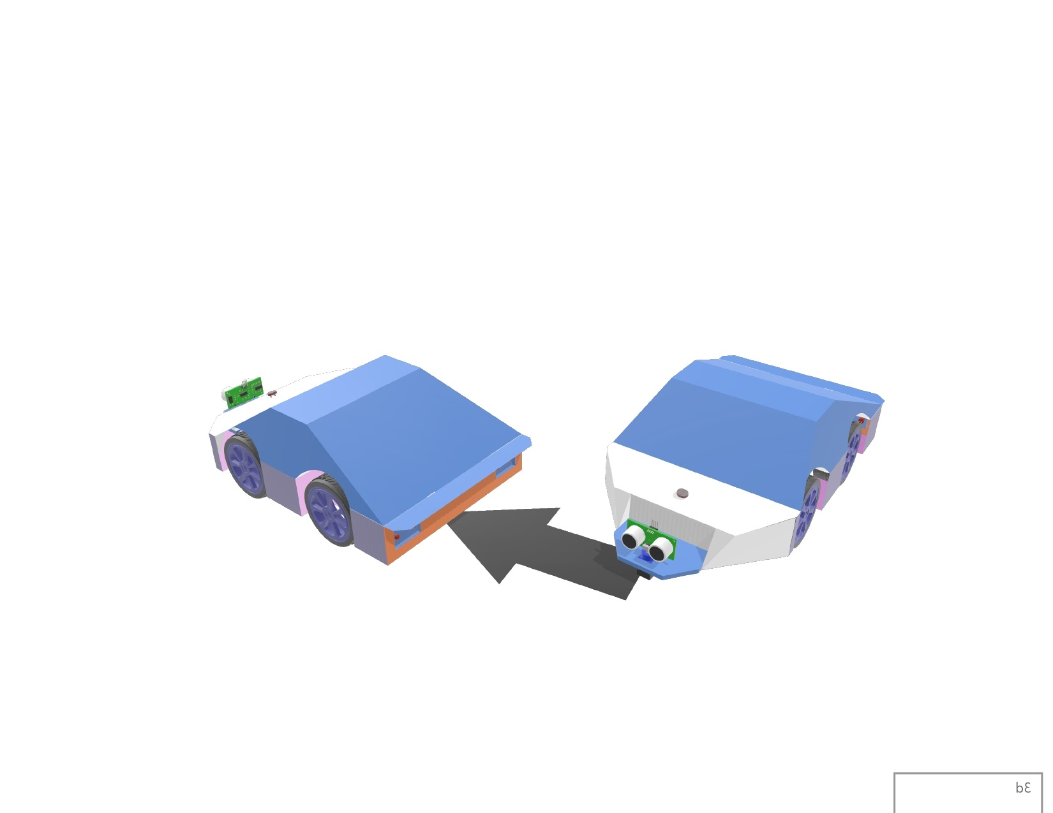
RIGHT Command

Slide 6
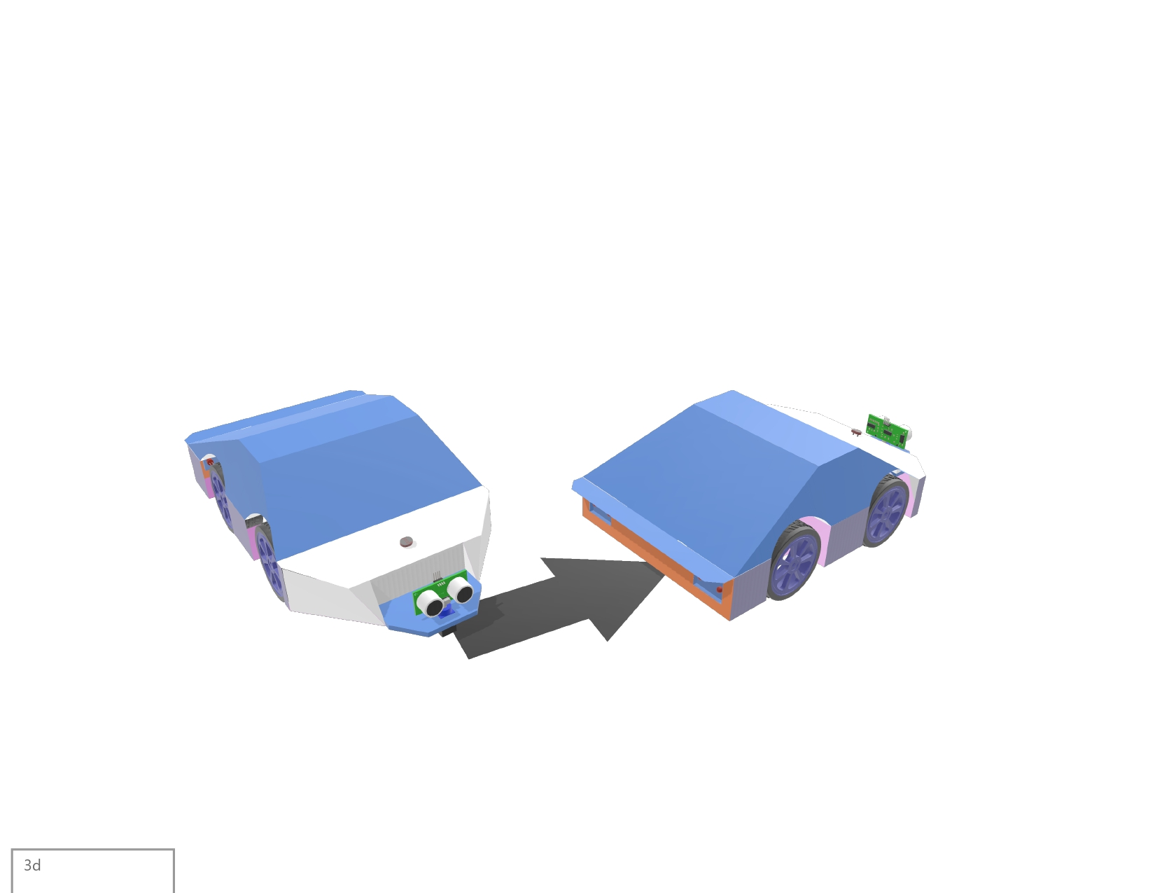
LEFT Command

Slide 7
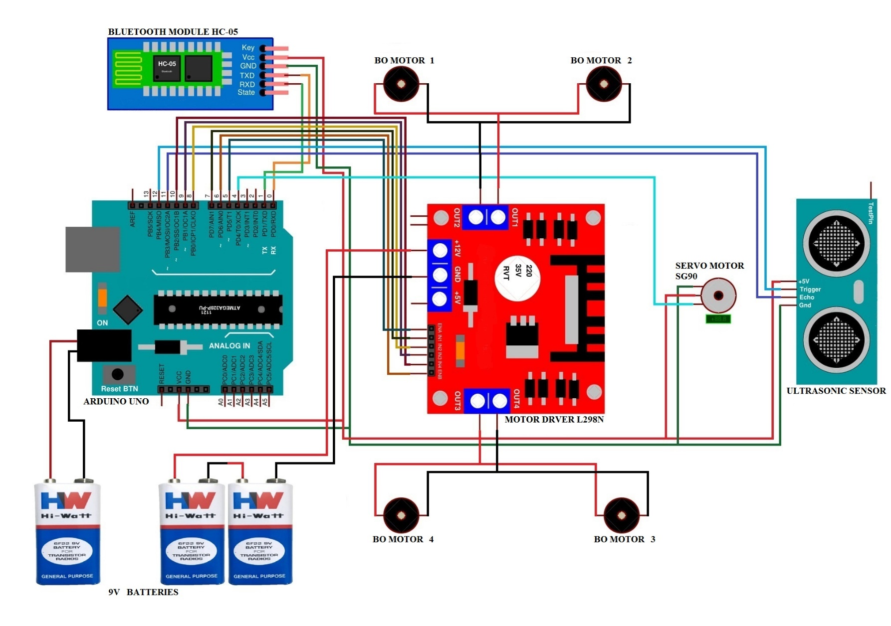
Circuit Diagram

Slide 8
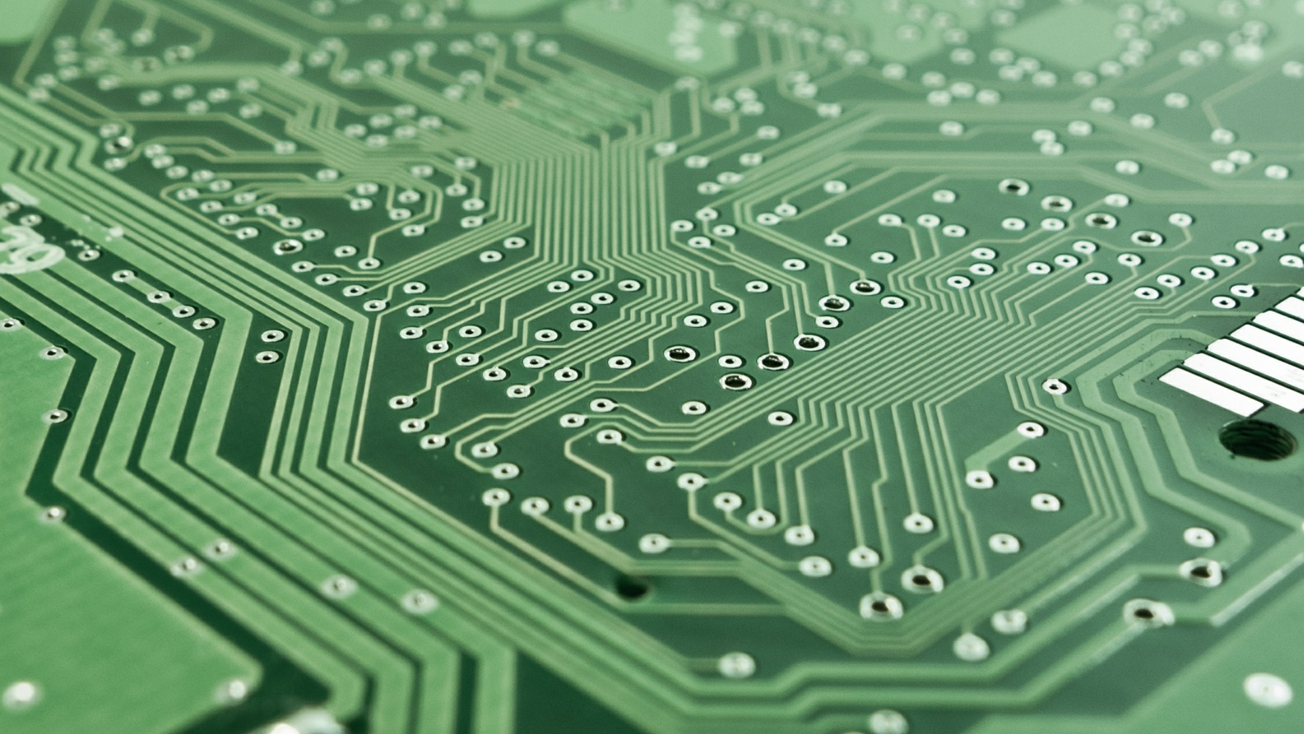
Advantages
Talking to Robots
Controlling Digital Devices
Enabling Hands Free Technology
Aiding the Visually- and Hearing-Impaired
Connecting with Internet Of Things

Slide 9
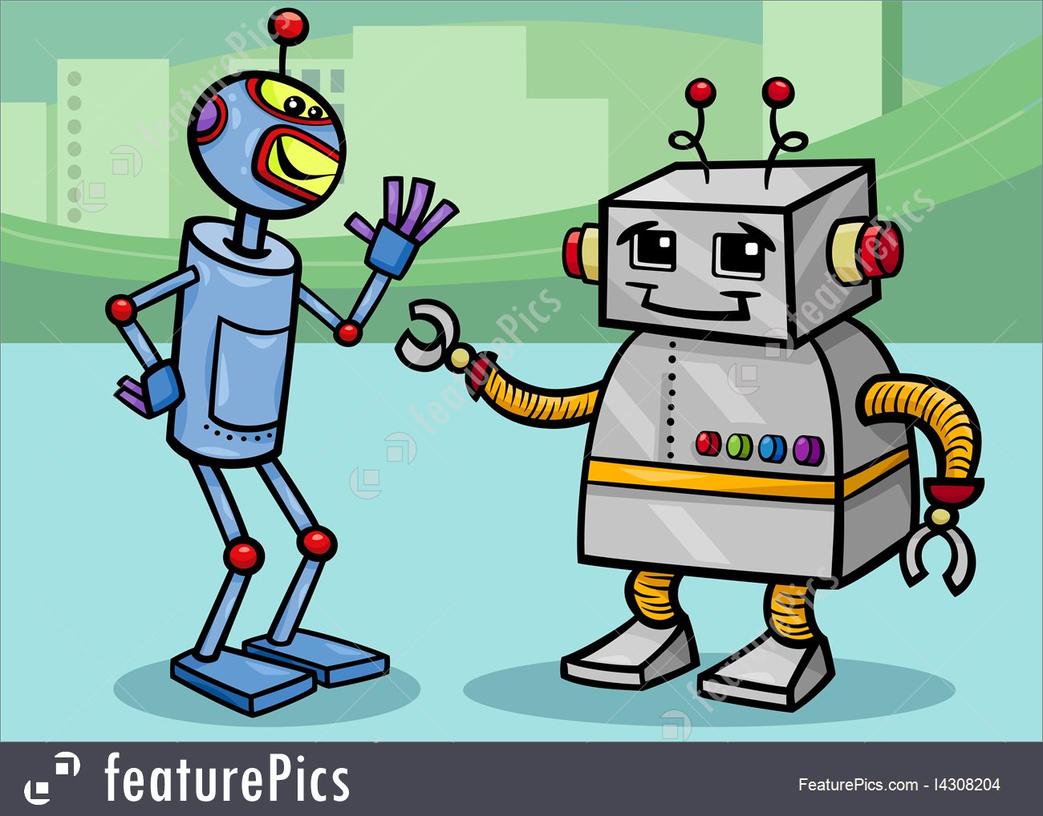
Talking to Robots
Safety is the most obvious
advantage of utilizing robotics.
Robots don’t get distracted or
need to take breaks.
Robots never need to divide their attention
between a multitude of things.
Robots will always deliver quality

Slide 10
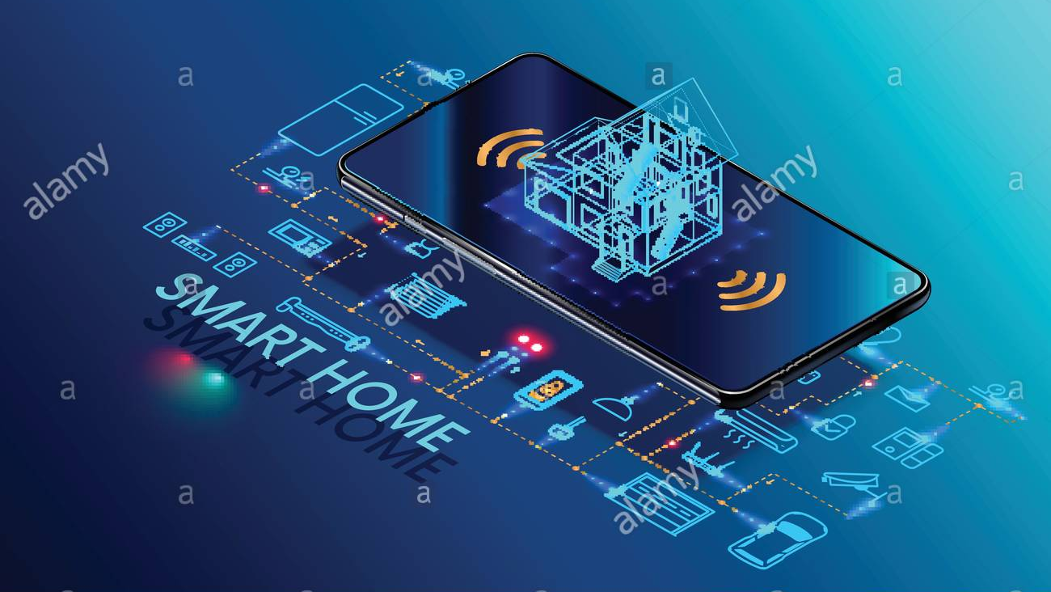
Controlling Digital Devices
Communication Speeds
Automation
Information Storage

Slide 11
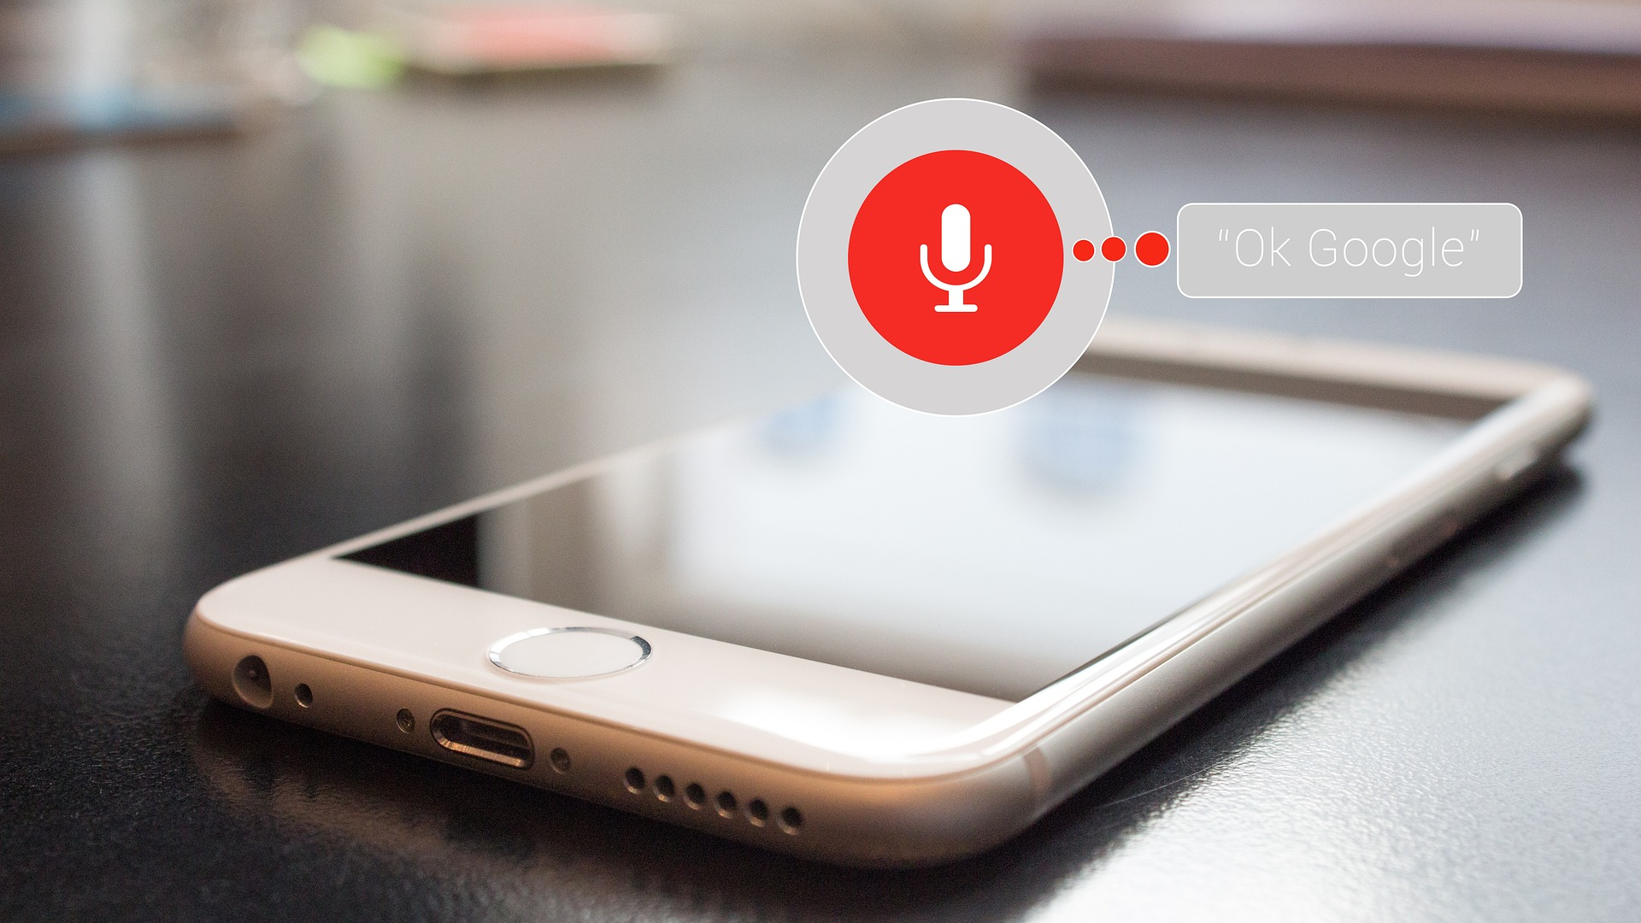
Enabling Hands Free Technology
When your eyes and hands are busy, then this technology will help, speech is incredibly useful.

Slide 12

Aiding the Visually
and Hearing-Impaired
People who having visual problem.
Voice technology is useful for them

Slide 13
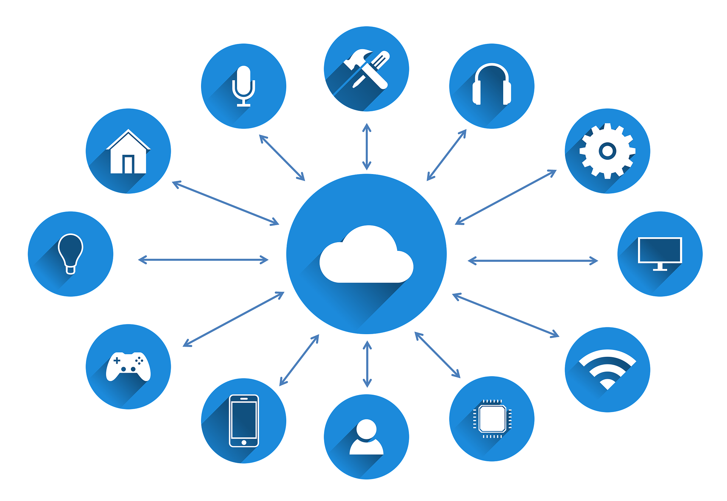
Connecting with
Internet Of Things
You can monitor the things connected to internet through your mobile phones, with the ability to control it.

Slide 14

Limitations
Lack of Accuracy and
Misinterpretation
Time Costs and Productivity
Accents and Speech Recognition
Background Noise Interference
Physical Side Effects

Slide 15

Lack of Accuracy
and Misinterpretation
Voice recognition software won't always put your words on the screen completely accurately.

Slide 16

Time Costs and Productivity
Time required for a project
Cost of a project
Productivity of project

Slide 17

Accents and Speech Recognition
Voice recognition systems can have problems with accents.

Slide 18
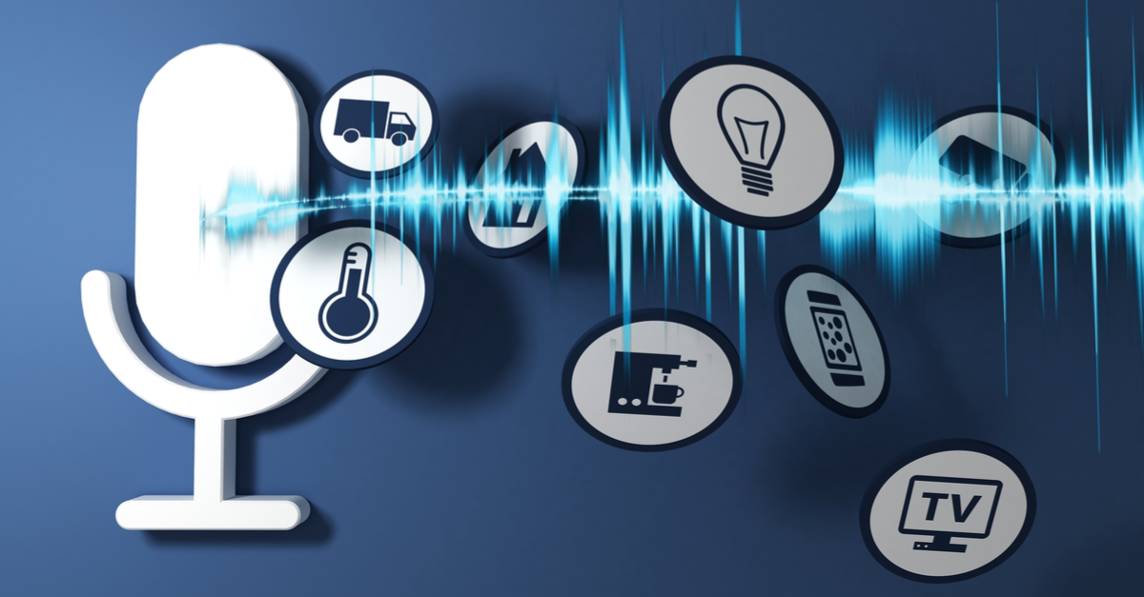
Background Noise Interference
To get the best out of voice recognition software, you need a quiet environment

Slide 19

Physical Side Effects
Using voice recognition technology frequently may cause
physical discomfort and vocal problems.

Slide 20


Thank You

